Slide 1
Analyzing FIFA’s data with Python

Slide 2
agenda
0. Introduction
1. Data Preparation and Cleaning
2. Exploratory Data Analysis (EDA)
3. Visualization
4. Statistical Analysis
5. Predictive Modeling
6. Conclusion

Slide 3
Introduction
I'll delve into the FIFA 19 dataset to uncover insights about football players featured in the popular video game. Using Python libraries such as NumPy, Matplotlib, Pandas, and Seaborn, I'll explore key variables including age, overall rating, potential, and market value.
This dataset provides a comprehensive view of players' attributes, from basic information like age to crucial metrics such as overall rating, representing their skill level in the game. Additionally, I'll examine potential, indicating a player's future development prospects, and market value, reflecting their worth in the virtual transfer market.
My analysis aims to uncover patterns and trends within these key variables, shedding light on the dynamics of player performance, growth potential, and market valuation in the FIFA 19 gaming universe.

Slide 4

Data Preparation and Cleaning

Slide 5
Familiarization with the Dataset
The first step in the project was to get to know the dataset by looking at its structure, identifying the types of data, and spotting any unusual or redundant columns. The dataset contains 92 columns and 17,954 entries, including player identifiers and detailed performance metrics. During this exploration phase, I noticed missing values in important financial metrics like value_euro and wage_euro, and in player availability such as release_clause_euro and club_join_date. Also, I found redundant or less important columns such as tags and traits, which had a high percentage of missing data. Moreover, initial statistical summaries helped show the range and distribution of numerical attributes, preparing me for deeper data cleaning and analysis.

Slide 6
Cleaning the Dataset
In the cleaning stage, I used Pandas to improve the dataset’s integrity and usability. Missing values were handled by either removing columns with too many missing values or filling in missing entries in important columns with median values for numbers and mode values for categories. This method helped keep as much data as possible without hurting the dataset's quality. I made data formats uniform by turning date strings in birth_date into Python datetime objects, which makes handling dates easier. Additionally, we created new columns like BMI to give more depth to the dataset for analysis. This cleaning process not only reduced the chances of bias and errors in future analyses but also made the dataset more manageable by reducing the number of columns from 92 to 87, focusing on the most relevant attributes for analysis.

Slide 7
Example by showing step1.ipynb

Slide 8
Exploratory Data Analysis

Slide 9
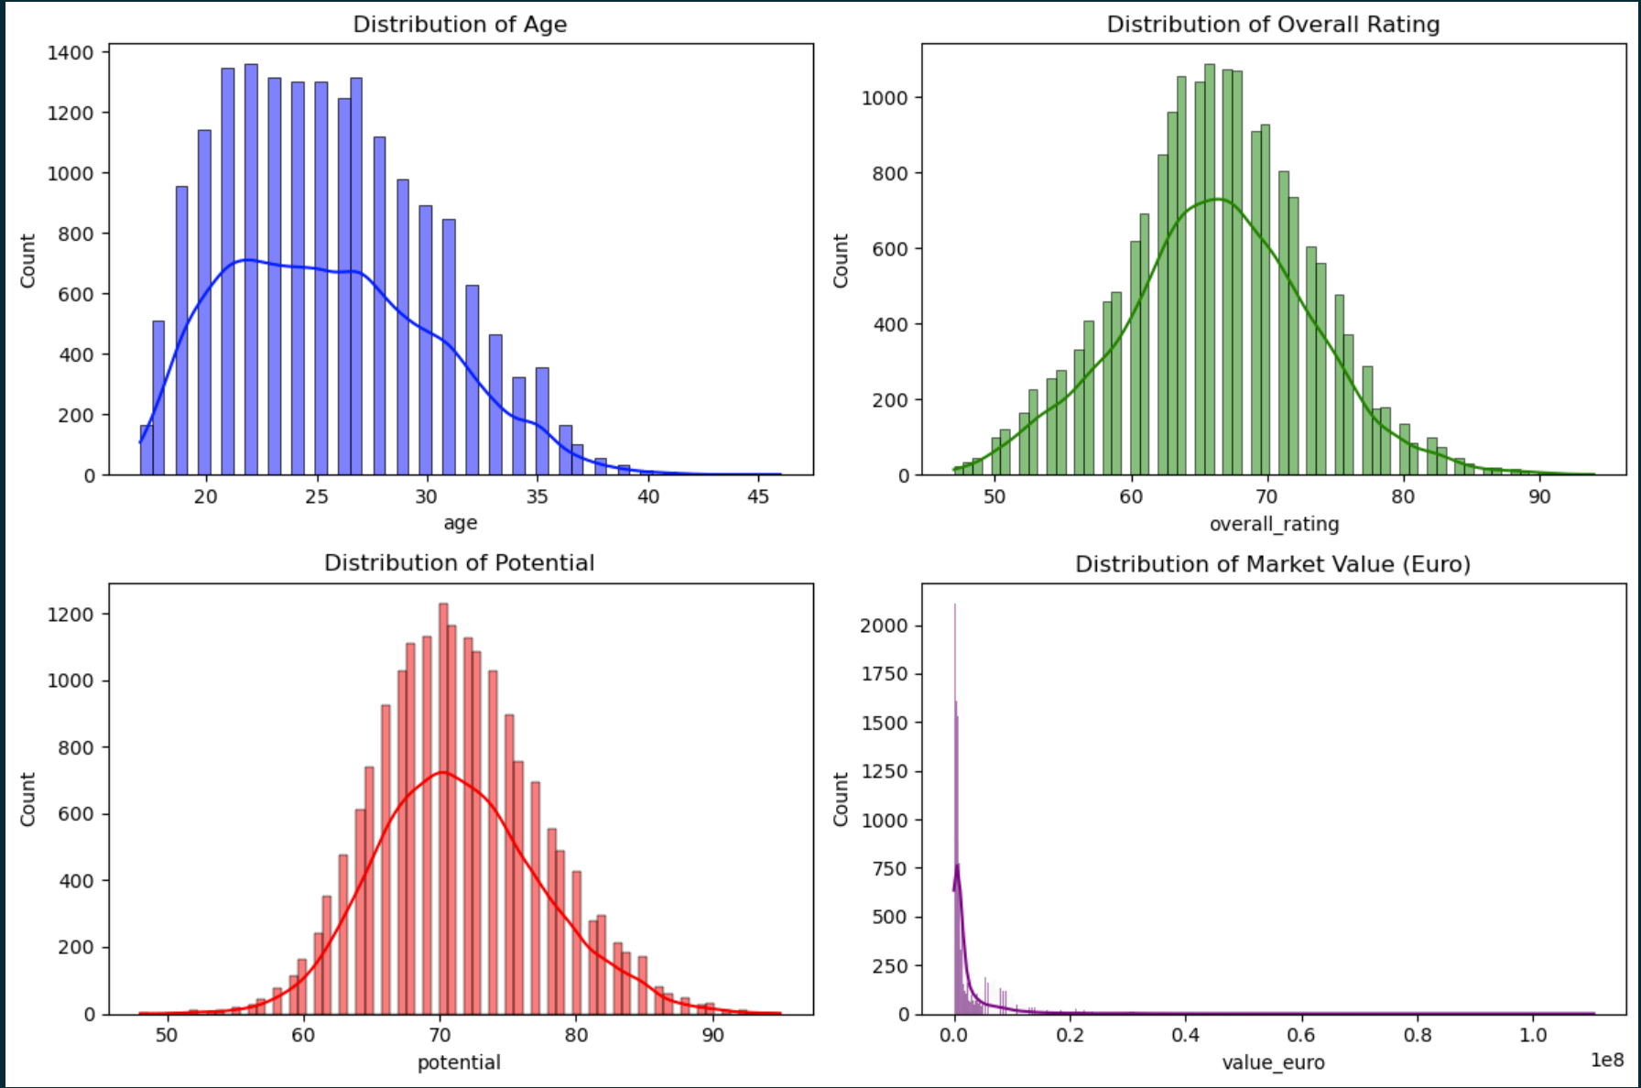
Visualizing Distributions of Key Attributes
Age: Suggest a younger player population with fewer older players.
Overall Rating: The distribution is somewhat normally distributed with a peak around the 60-70 rating mark.
Potential: Indicates that many players have higher potential ratings than their current overall ratings.
Market Value: Indicates most players are valued at the lower end of the market value spectrum, and a few outliers with very high values

Slide 10
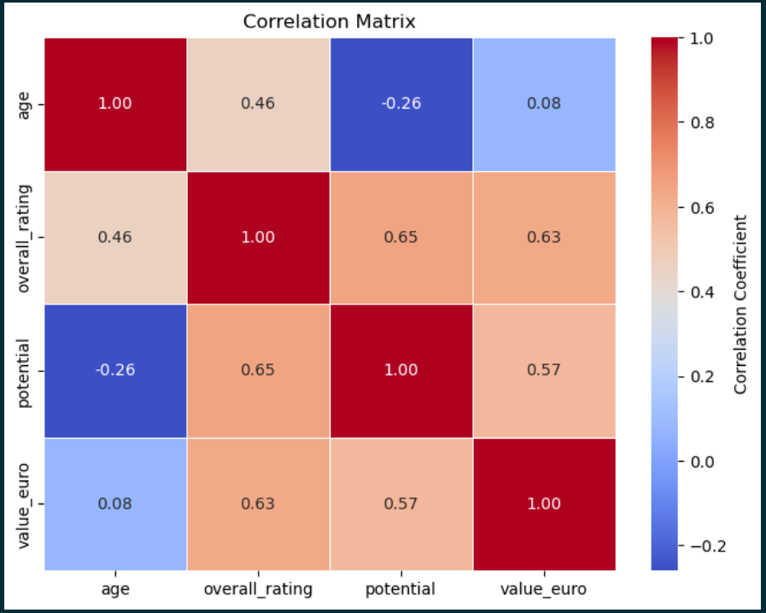
Analyzing Relationships Between Attributes
Insights:
Better-rated players are likely more valuable.
Younger players tend to have higher potential ratings.
As players get older, their market value might increase up to a certain point before it likely declines.

Slide 11
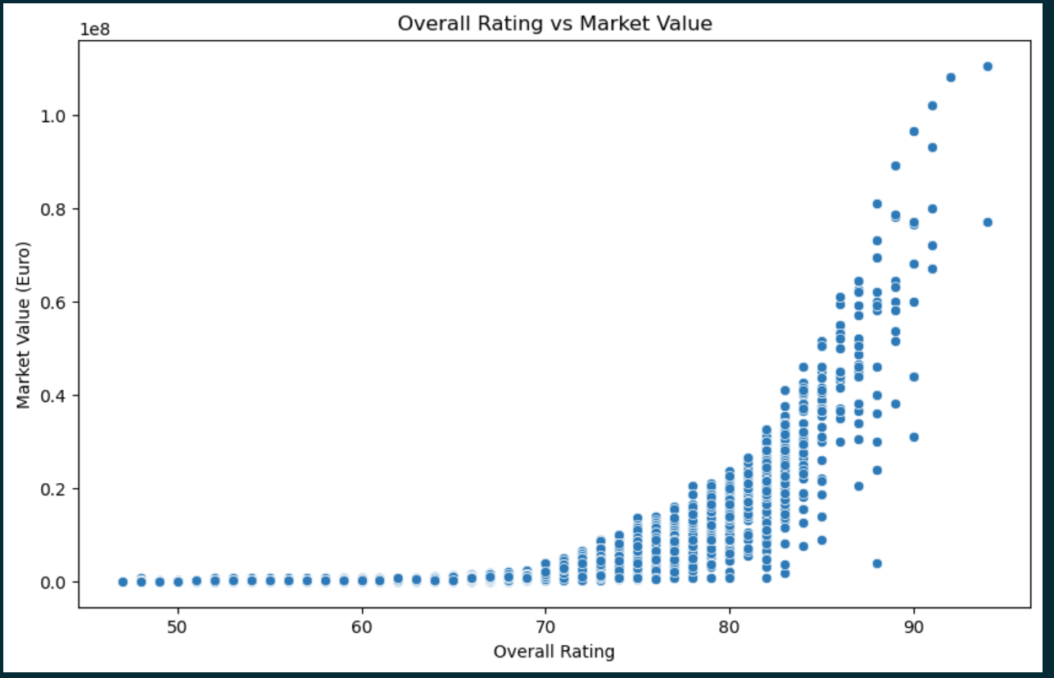
Analyzing Relationships Between Attributes
Market value tends to increase with higher ratings.
greater variability in the market value of top-rated players.

Slide 12
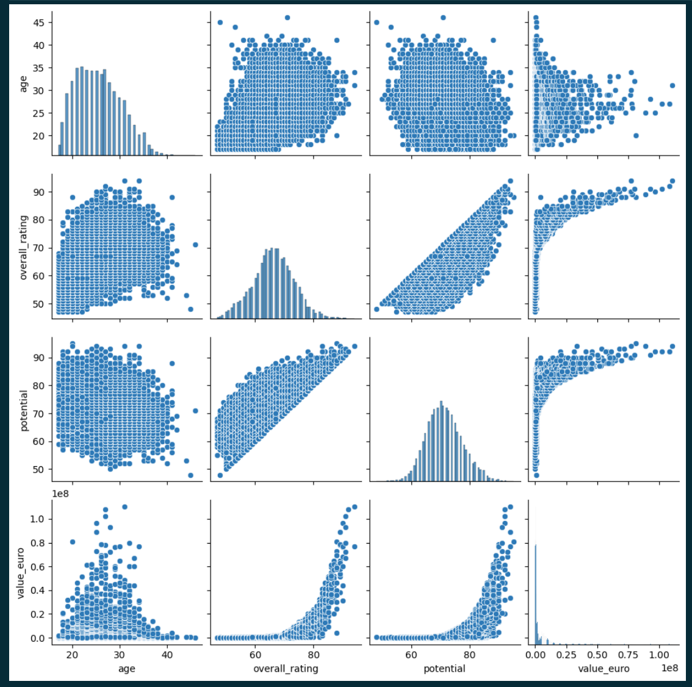
Pair Plot for Selected Features
The scatter plots between potential and overall rating show a dense clustering along a line, indicating a strong positive relationship.
The relationship between market value and other numerical features like age, overall rating, and potential shows how these factors influence a player's market valuation, with clear trends visible in how players' values increase with better ratings and potential.

Slide 13
Visualization

Slide 14
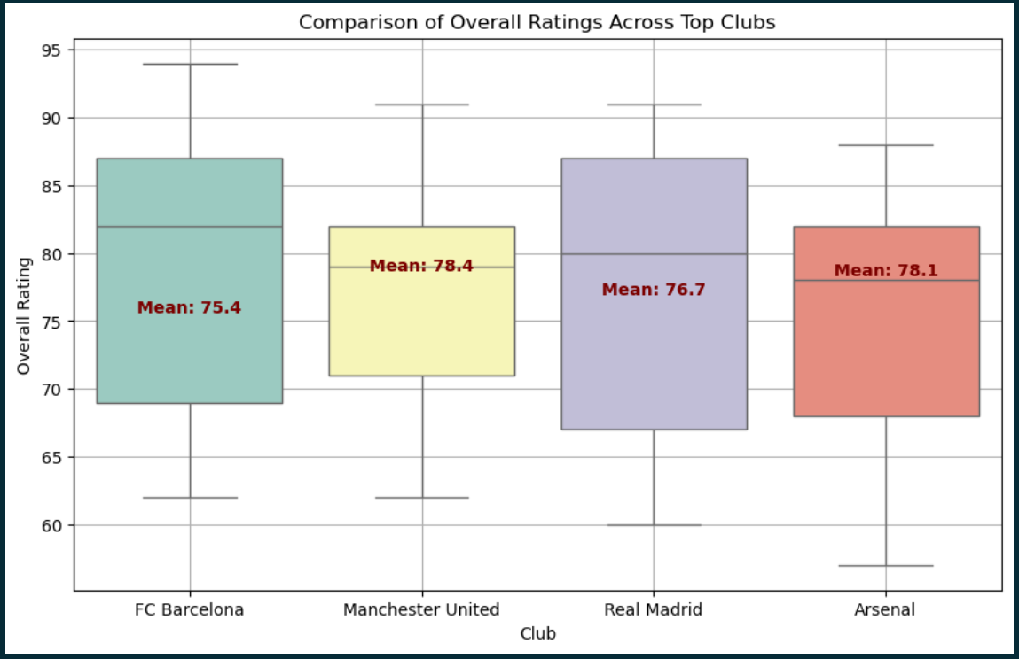
Comparative Visualizations of Top Clubs
FC Barcelona and Real Madrid show higher median ratings and a tighter interquartile range (IQR), indicating not only high-quality players but also less variation in player quality.
Arsenal displays a broader IQR, suggesting more variability in player ratings within the club.

Slide 15
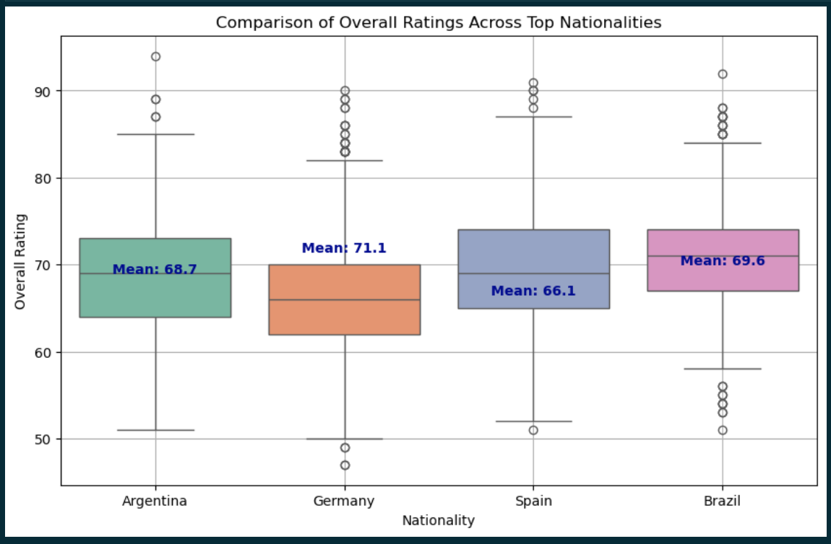
Comparative Visualizations of Top Country
Germany and Spain have a denser IQR, suggesting more consistency in player quality.
Argentina and Brazil show several outliers, indicating some players with exceptionally high ratings, which could be players like Messi for Argentina.
The median ratings are relatively similar across these countries, but the variability and outliers differ significantly.

Slide 16
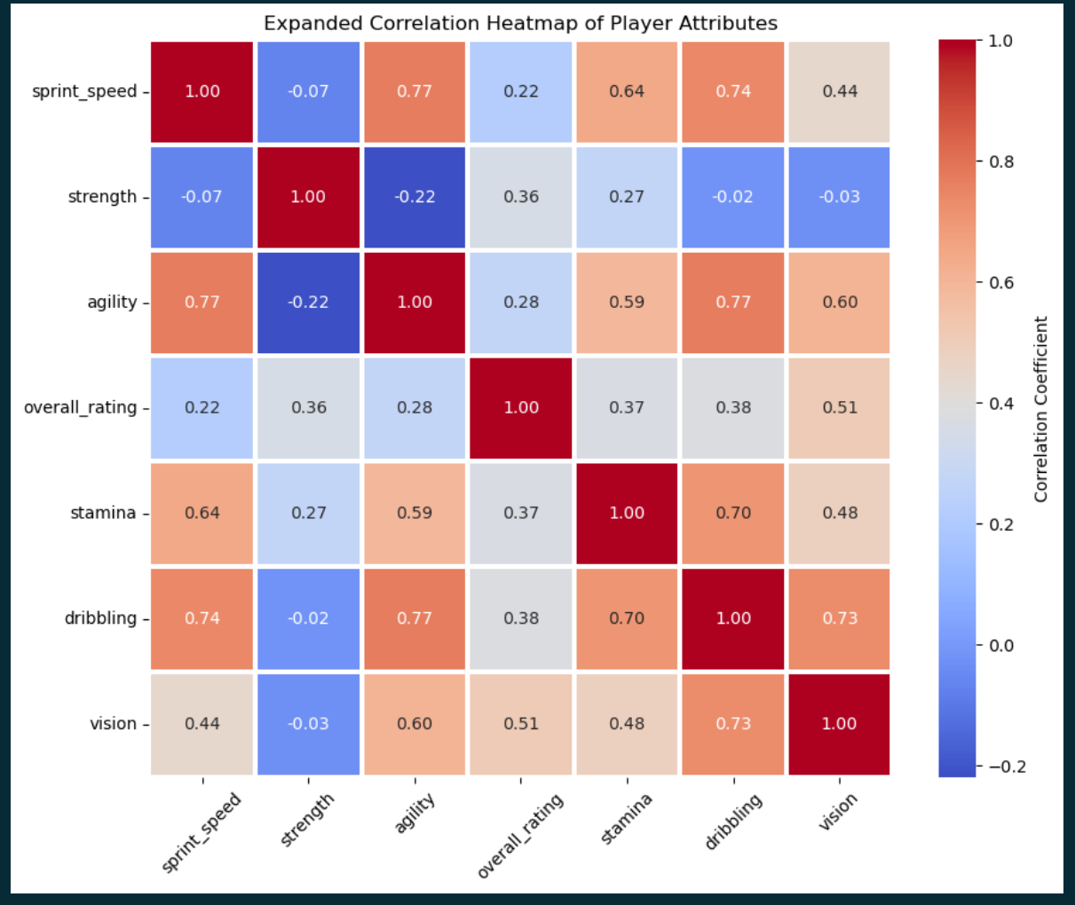
Correlation Heatmap of Player Attributes
Sprint Speed and Agility: Faster players tend to be more agile. This is expected as agility contributes to effective changes in direction at speed.
Sprint Speed and Dribbling: Faster players tend to have better dribbling skills. This could indicate that quicker players are more effective in dribbling past opponents.

Slide 17
Correlation Heatmap of Player Attributes
Strength and Agility: Stronger players are less agile. This might reflect the different physical builds and roles expected of players who rely more on strength versus those relying on agility.
Overall Rating: There are moderate positive correlations with strength (0.36), agility (0.28), stamina (0.37), dribbling (0.38), and vision (0.51). This shows that a player's overall quality is somewhat influenced by their physical capabilities and technical skills.

Slide 18
Correlation Heatmap of Player Attributes
Stamina and Sprint Speed: Players with good stamina also tend to have higher sprint speeds, possibly indicating good overall physical conditioning.
Dribbling and Agility: Agility is crucial for effective dribbling, which makes sense as quick, precise movements are key to maintaining control of the ball while maneuvering around opponents.

Slide 19
Correlation Heatmap of Player Attributes
Vision and Dribbling: Players who are good at dribbling also tend to have good vision. This might reflect the necessity of anticipating player movements and spotting openings during play.
Vision and Overall Rating: Players with better vision are generally rated higher, highlighting the importance of cognitive skills in football.

Slide 20
Statistical Analysis

Slide 21
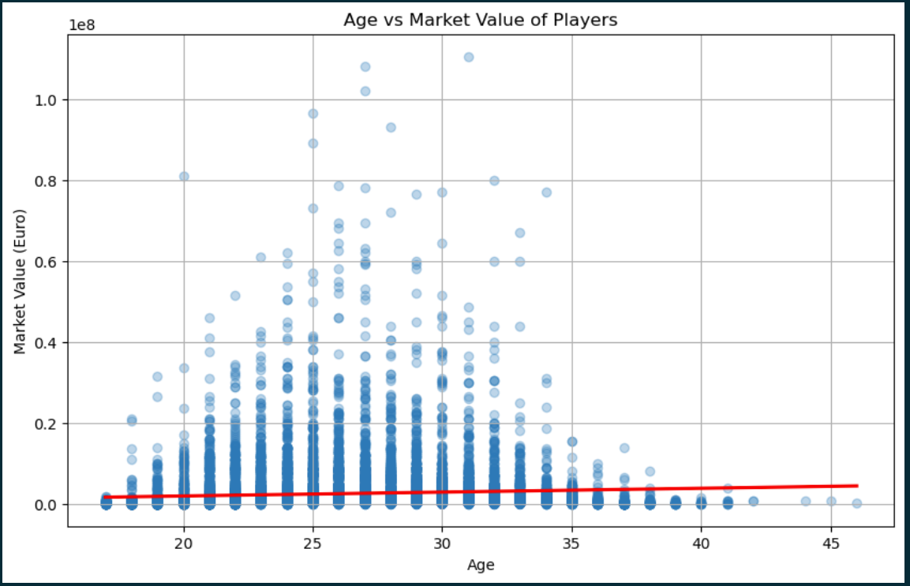
Age vs. Market Value
Observations: The scatter plot shows a wide spread of market values across different ages with a lot of variability, especially in the younger and middle age ranges. The regression line appears almost flat, indicating that there is no strong linear relationship between age and market value across the dataset.
Insights: While age is a factor in player valuation, it's not a strong predictor of market value on its own. The high variability could be influenced by other factors like player skill, position, and reputation, which are not accounted for merely by age.

Slide 22
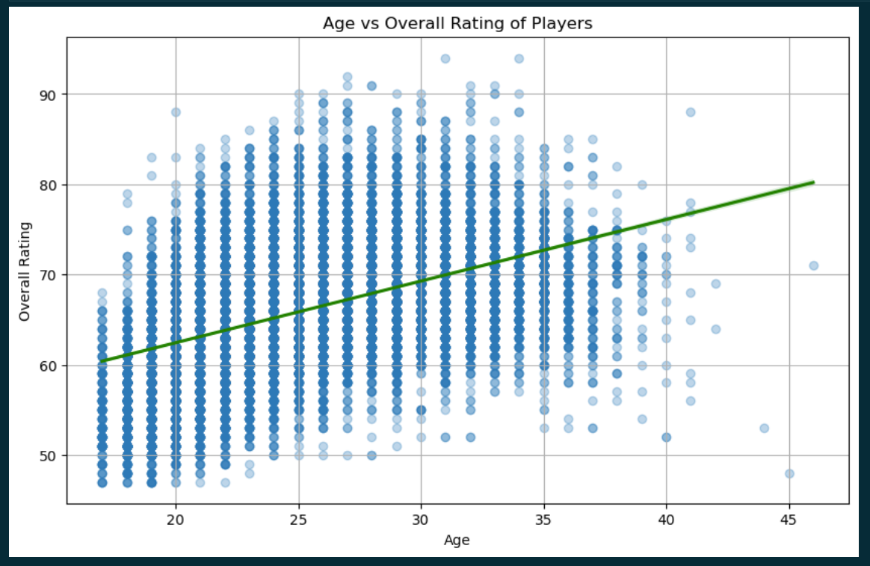
Age vs. Overall Rating
Observations: A clear upward trend, showing that overall ratings generally improve with age up to a certain point before plateauing or possibly declining. The density of data points is higher in the age range from about 20 to 30 years.
Insights: The positive trend indicates that experience, which correlates with age, likely contributes to higher player ratings. This could reflect skill maturation and accumulated professional experience, which are valued highly in player ratings.

Slide 23
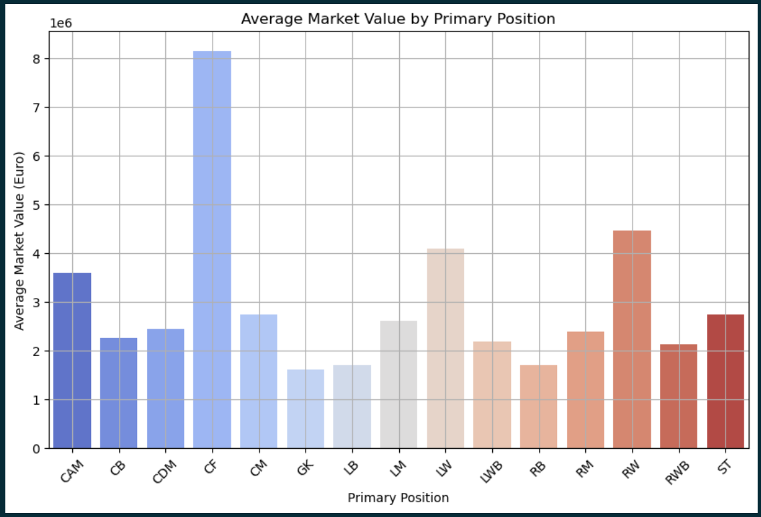
Average Market Values by Primary Position
Observations: Significant differences in average market values across different positions, with some positions like CF and ST having higher average market values compared to others like GK or LB.
Insights: Offensive positions are often valued higher in the market, likely due to their direct impact on scoring goals, which is a highly visible and critical aspect of football performance. This aligns with common football market trends where goal-scoring players command higher transfer fees and wages.

Slide 24
Predictive Modeling

Slide 25
Example by showing step5.ipynb

Slide 26
Regression Model to Predict Player Market Values
Mean Squared Error (MSE): 15366938321419.674. The mean squared error remains quite high, which suggests that the model's predictions still deviate significantly from actual market values. The high error value indicates that the model might be missing some critical predictors or that the relationship between predictors and target is not purely linear.
R² (R-squared): 0.5879. The R-squared value has improved to approximately 0.588, indicating that about 58.8% of the variability in player market values is explained by the model. This is an improvement and suggests better predictive power compared to the previous model, yet there is room for improvement.

Slide 27
Regression Model to Predict Player Potential
Mean Squared Error (MSE): 6.402972261314623. The MSE is relatively low, indicating good model performance in terms of error magnitude relative to the scale of potential ratings.
R² (R-squared): 0.8317. An R-squared value of 0.832 suggests that the model explains a substantial majority (83.2%) of the variance in potential ratings, which is an excellent result for predictive modeling.

Slide 28
Conclusion
Future work could look into more complex algorithms, better feature engineering, and the use of real-time data to further improve the models' predictive power and trustworthiness. This project sets a strong base for using data-driven methods in sports analytics, leading to better-informed decisions in football management.

Slide 29
Thank you
Sayf Elhawary

